Slide 1
Crowdy
SC2006 SOFTWARE ENGINEERING · LAB 5
Check how crowded Singapore’s malls and MRT stations are before you go, and find a fair place for friends to meet.
SCSJ Group 3 · Tan Leong Jun Joseph · Teo Kok Wei, Oscar · Mao Yikai · Xu Hanwen · K Eswaran
Notes:
“Hi, we’re SCSJ Group 3, and this is Crowdy.”
“Crowdy is an iOS app that tells you how crowded Singapore’s malls and MRT stations are before you go. It also suggests quieter malls nearby, gives directions, and helps a group of friends pick a mall that’s fair for everyone to reach.”
“I’ll show the app live, and explain the software engineering behind each part as we go: the requirements, the design and how we tested it.”

Slide 2
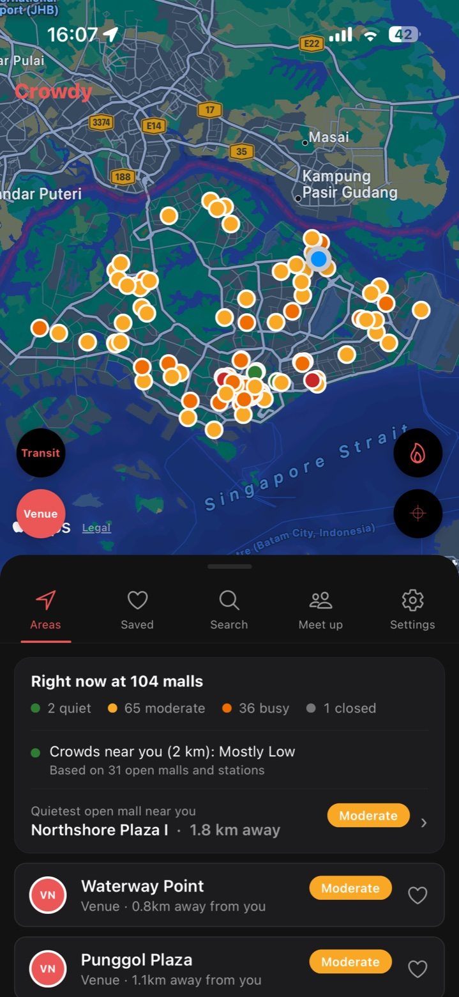
You only find out a place is packed when you get there.
THE PROBLEM
Crowdy shows how busy 104 malls and every MRT/LRT station are before you leave, points you to quieter malls nearby, and helps a group of friends choose a mall that is fair for everyone to reach.
For commuters, students and residents in Singapore. Works as a guest, with an account for synced saves and friends.
Notes:
“The problem is simple: you usually only find out a mall or a train station is packed once you’re already there.”
“Crowdy shows how busy 104 malls and every MRT and LRT station are before you leave. If a mall is busy, it points you to quieter ones nearby. And when friends want to meet up, it suggests a mall that’s fair for everyone to reach by public transport.”
“It’s for commuters, students and residents. Anyone can use it as a guest. An account is only needed to sync saved places and to add friends.”
“This is the home screen you’ll see in the demo.”

Slide 3
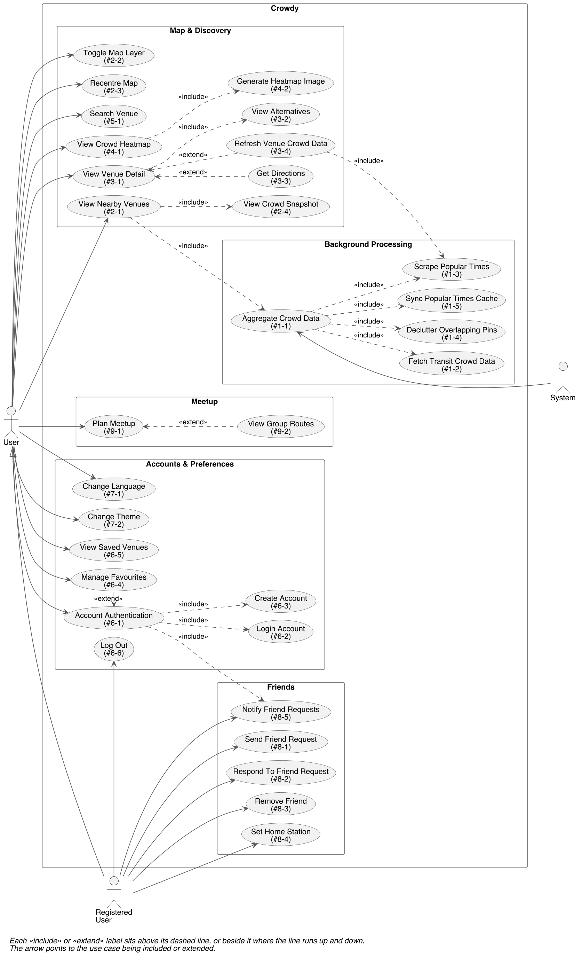
31 use cases in nine groups
1 Background crowd data
6 Accounts and saved venues
2 Map and nearby venues
7 Preferences
3 Venue detail
8 Friends
4 Crowd heatmap
9 Meetup planner
5 Search
Three actors: User (guest), Registered User (signed in) and the System (the backend on its own schedule).
Notes:
“Here’s our use case model. It has 31 use cases in nine groups.”
“There are three actors. A User is anyone, signed in or not. A Registered User is a signed-in user, who can also add friends and set a home station. The System is our backend, which collects crowd data on its own schedule.”
“The nine groups match the nine system features in our SRS, numbered the same way, so a requirement like REQ-9.1 belongs to group 9, the meetup planner.”

Slide 4
Three free data sources, combined
LTA DataMall
Google Popular Times
OneMap
Live crowd level at every MRT/LRT station, refreshed every 5 minutes. Carpark lots for malls.
Public transport, walking, driving and cycling routes, and the travel times behind the meetup planner.
Each mall’s typical week, hour by hour, and its opening hours.
None of them answers “where should we go right now?” on its own. Crowdy merges them into one venue list.
Notes:
“Crowdy is built on three free data sources.”
“LTA DataMall gives the live crowd level at every MRT and LRT station, updated every five minutes. We also use its carpark data on mall pages.”
“Google Popular Times gives each mall’s typical week, hour by hour, plus its opening hours. Google has no official API for this, so our backend reads it from Google Maps with a headless browser, slowly, about one mall every 15 to 25 seconds, once a week per mall. That runs on one machine and the results are shared with the rest of the team through our database.”
“OneMap, from the Singapore Land Authority, gives us routes and travel times for directions and the meetup planner.”
“None of these answers ‘where should we go right now?’ on its own. The backend merges them into one venue list. That’s use case AggregateCrowdData, #1-1.”

Slide 5
Demo
Home map and the Right now card
Selecting a venue
Venue page and quieter alternatives
Directions with live station crowds
Heatmap and search
Accounts, saved venues and security
Friends and the request alert
Meetup planner and group routes
English / 中文, dark and light
Notes:
“The backend merges every source into one list. Stations refresh every 5 minutes, malls weekly, and if a source fails we keep serving the last data, so the app never goes blank.”
“It expands in place and the list holds still. In testing, the list kept reshuffling as the map moved, so we fixed that.
“Alternatives are up to three quieter malls within 3 km."
"We chose OneMap because it’s free and authoritative for Singapore.”
Turn on the heatmap, then search a postal code or a misspelt mall.
“The heatmap is drawn on the server and cached for 5 minutes. Search runs on the phone, forgives one typo.
“Passwords are bcrypt hashes, sessions expire after 30 days, sign-in is rate limited per client, and a wrong username and a wrong password give the same error. Guests can save places, and when they sign in we ask before adding those to the account.”
Sign out and back in as user_1. The friend request alert appears. Tap View, then Accept.
“The alert uses the Observer pattern: when waiting requests change, every badge updates. A home station is only visible to accepted friends.”
Meet up tab: add yourself, user_2 as a friend, two people by station, pick Least crowded and a later time, then Find places to meet.
Open See everyone’s routes, tap a person, switch Arrive by and Leave at. “It ranks malls by fairness, average trip and crowd. For a later time it uses each mall’s usual crowd then and that time’s timetable.
Settings: switch to 中文 and back, toggle dark mode. “All text lives in one file in both languages.”

Slide 6
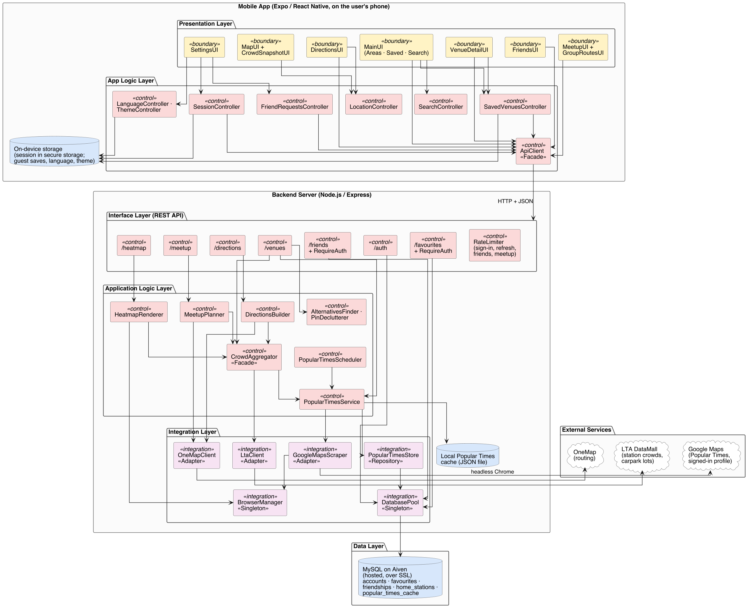
Layered architecture
App: screens (boundary) call controllers, and only ApiClient talks to the server.
Server: routes, then application logic, then adapters for LTA, Google, OneMap and MySQL.
Database: hosted MySQL on Aiven, plus a local Popular Times cache.
Notes:
“This is our system architecture. It has two parts: the app on the phone and our backend server.”
“In the app, the screens are boundary classes. They call control classes, like the session or saved-venues controllers. Only one class, ApiClient, ever talks to the server.”
“On the server, requests go through three layers: the routes, then the application logic, then adapters that talk to LTA, Google, OneMap and the database.”
“The database is MySQL hosted on Aiven. It holds accounts, favourites, friends and a shared copy of the Popular Times data. Each backend also keeps a local cache, so it keeps working if the database is down.”
“Because the app only talks to the server through ApiClient, we can change a data source on the server without touching any screen."

Slide 7
Software engineering principles
Separation of concerns
Low coupling, high cohesion
Information hiding
App and server are separate. Screens, controllers and entities are kept apart.
PopularTimesStore hides the SQL. OneMapClient keeps its login token to itself.
Screens only know ApiClient. Each adapter wraps one outside service.
Abstraction
Don’t repeat yourself
Fail-safe design
One Venue type for malls and stations, so every screen treats them alike.
One strings file for both languages. One step row shared by directions and group routes.
If a source fails, the last good data is kept. A local cache covers a database outage.
Notes:
“These are the main software engineering principles behind our design, each with where you can see it in Crowdy.”
“Separation of concerns: the app and the server are separate programs. Inside each, screens, the controllers that hold the logic, and the entity types are kept apart. That’s the boundary, control and entity split from our class diagrams.”
“Low coupling and high cohesion: the screens only know ApiClient, nothing about LTA, Google or OneMap. On the server, each adapter wraps exactly one outside service. Because of that, when we replaced the Lab 1 carpark-based crowd estimate with Google Popular Times, no screen had to change.”
“Information hiding: other code never sees how things work inside. PopularTimesStore hides the SQL behind save and load. OneMapClient logs in and keeps its token to itself. Passwords and API keys live only in the server’s environment file.” “
Abstraction: malls and stations come from different sources, but both are the same Venue type, so the map, the list and the venue page treat every venue the same way.”
“Don’t repeat yourself: every piece of text is in one strings file with English and Chinese side by side, and the route step row is written once and reused by both directions and group routes.”
“Fail-safe design: if LTA or Google fails, we keep serving the last good data instead of showing nothing, and if the database is down the server keeps working from its local cache.”

Slide 8
SOLID in Crowdy
Principle | Where it shows
Single responsibility | Each server service owns one concern: lta.ts talks to LTA, popularTimes.ts handles Popular Times, meetup.ts ranks malls
Open/closed | Heatmap, friends and meetup were added as new modules, without editing the crowd data code
Liskov substitution | A mall from Google and a station from LTA are both Venues, and either can be used wherever a Venue is expected
Interface segregation | ApiClient offers small, specific functions (getFavourites, sendFriendRequest) instead of one general request call
Dependency inversion | Routes call service functions such as getVenues(), not Puppeteer or LTA directly, so a data source can change underneath
Notes:
“Here’s how each of the five SOLID principles shows up in our code.”
“Single responsibility: each server service has one job. lta.ts only talks to LTA, popularTimes.ts only handles Popular Times, and meetup.ts only ranks malls. If LTA changes its API, only one file changes.”
“Open/closed: the system is open to extension but closed to modification. We added the heatmap, friends and the meetup planner as new routes and services beside the existing ones, without editing the crowd data code.”
“Liskov substitution: a mall from Google and a station from LTA both satisfy the same Venue type, so any code that works with a Venue, like the map, the list or the alternatives search, works with either.”
“Interface segregation: ApiClient gives each screen small, specific functions like getFavourites or sendFriendRequest, instead of one general request function that every screen has to configure.”
“Dependency inversion: the routes depend on service functions like getVenues(), not on Puppeteer or the LTA API directly. So how crowd data is collected can change without touching the routes or the app.”

Slide 9
Design patterns
Pattern | Where | Why
Facade | ApiClient, CrowdAggregator | One entry point over many calls and sources
Adapter | LtaClient, GoogleMapsScraper, OneMapClient | Turn each outside service into Crowdy’s own types
Singleton | BrowserManager, DatabasePool | One shared browser and one connection pool
Repository | PopularTimesStore | Hides the database behind save and load
Observer | Session, Language, Theme, FriendRequests | Screens update when shared state changes
Each pattern is marked on the class diagrams in SRS Appendix B.
Notes:
"These are the design patterns we used.”
“Facade: ApiClient on the app and CrowdAggregator on the server each give one simple entry point over many calls. The screens just ask for venues and don’t care where the data comes from.”
“Adapter: each outside service has an adapter that turns its data into our own types, so the rest of the system never sees LTA’s or OneMap’s format.”
“Singleton: there’s one shared headless browser and one database connection pool, reused by every request instead of opening new ones each time.”
“Repository: PopularTimesStore hides the database behind simple save and load functions.”
“Observer: the four app controllers notify the screens that use them when their state changes. For example, when a friend request arrives, every badge updates by itself.”
“Each of these patterns puts the principles from the last two slides into practice: the Facade and Adapter keep coupling low, and the Repository hides information.”

Slide 10
Design choices we made
A list that holds still
Ask before merging
OneMap over Google
Found in testing: the list reshuffled as the map moved. It now freezes while a venue is selected.
Guest saves are added to an account only after asking, fixing a leak between accounts on one phone.
Free, no billing account, authoritative for Singapore.
In-app alerts
Fast meetup search
Friend requests alert on sign-in and on return to the app, with no push service needed.
Shortlist by distance, at most 8 lookups at once, trips cached for 6 hours.
Notes:
“These are some of the design choices you saw in the demo, and why we made them.”
“The list holds still: in our own testing, the list reshuffled every time the map moved to a venue, which was confusing. Now it freezes while a venue is selected.”
“Ask before merging: guests can save places on the phone. We used to merge those into any account that signed in, which leaked one person’s saves into the next account on a shared phone. Now the app asks first.”
“OneMap over Google: Google Directions needs a billing account. OneMap is free and is the official source for Singapore.”
“In-app alerts: friend requests show an alert when you sign in or come back to the app. That keeps everything inside the app without setting up a push notification service.”
“Fast meetup search: we shortlist malls by straight-line distance first, so only a few get real route lookups. At most 8 run at once, and repeated trips are cached for 6 hours. That’s requirement PER-6.”
If asked about Expo Go lol: “It let us test quickly on our own phones for a feel of the app using touchscreen elements/testing. The trade-off is no map on Android and an iOS-only heatmap, which we document as constraints in SRS 2.5.”

Slide 11
Testing and quality
48
24
0
server tests, all passing
app tests, all passing
critical findings in the Scantist scan
Black-box tests (equivalence classes, boundary values) and white-box basis path tests from Lab 4
Security: bcrypt passwords, signed session tokens, rate limiting per client
JSDoc on key classes and public methods
Notes:
“For quality, we have 48 automated server tests and 24 app tests, and they all pass.”
“They include our Lab 4 tests. The black-box tests use equivalence classes and boundary values, and the white-box tests use basis path testing. The server tests use a fake in-memory database, so they never touch the real data.”
“We also ran a Scantist security scan. It found no critical issues. Scantist did suggest two small server tidy-ups, limiting which websites can call the server and hiding the server software header, and we made both.”
“For security in general: passwords are stored only as bcrypt hashes, sessions are signed tokens, and sign-in, refresh, friend requests and meetup searches are rate limited per client.” “And key classes and public methods are documented with JSDoc.”

Slide 12
ViewAlternatives (#3-2)
TRACEABILITY 1
Requirement
Use case
Design
Code
Tests
REQ-3.6: up to 3 quieter malls within 3 km, nearest first
#3-2: same category, within 3 km, lower crowd, sorted by distance
AlternativesFinder, called by VenueController (Figure B.4)
server/src/services/ alternatives.ts, findAlternatives
Lab 4 black-box tests: BB-10 at 3.000 km is in, BB-11 at 3.001 km is out
One requirement, followed from the SRS to the use case, the class diagram, the code and the tests.
Notes:
“To show traceability, here’s one feature you saw in the demo, the quieter alternatives on a mall’s page, followed all the way through.”
“It starts as requirement REQ-3.6 in the SRS: suggest up to three quieter malls within 3 km, nearest first.”
“That’s realised by use case ViewAlternatives, #3-2, whose flow is: same category, within 3 km, lower crowd, sorted by distance.”
“In the design, that’s the AlternativesFinder class, called by VenueController, in class diagram B.4.”
“In the code, it’s the findAlternatives function in alternatives.ts.”
“And it’s tested by our Lab 4 black-box tests. For example, test BB-10 puts a mall at exactly 3.000 km and expects it included, and BB-11 puts one at 3.001 km and expects it left out. That’s boundary value testing.”

Slide 13
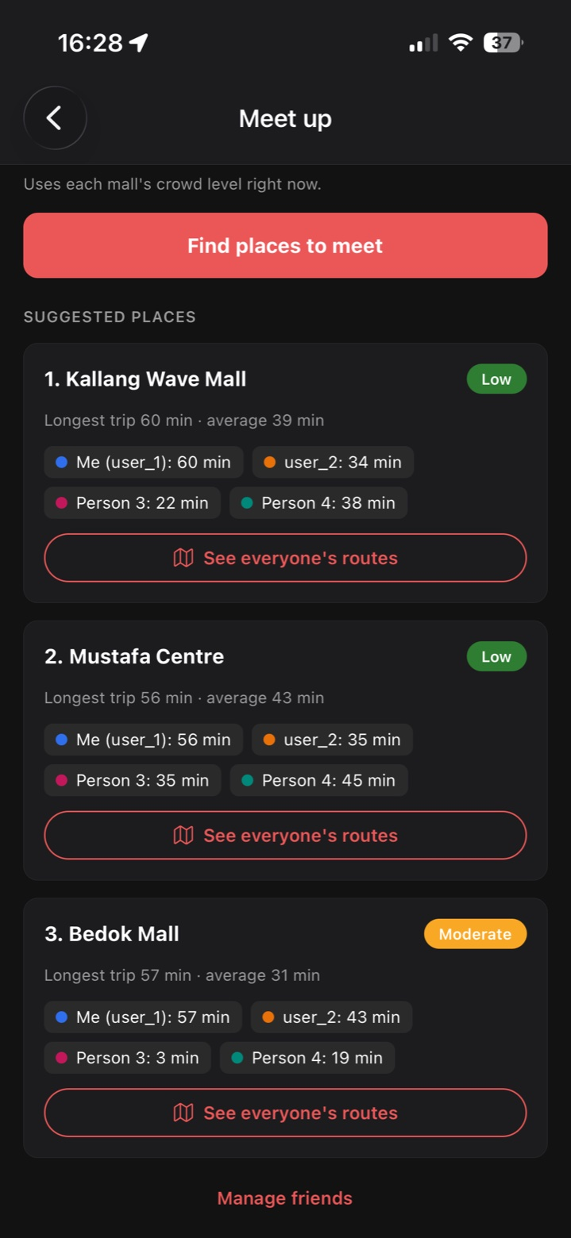
PlanMeetup (#9-1)
TRACEABILITY 2
Step | Where
Requirements | REQ-9.1 to REQ-9.10
Use case | #9-1, with later time, friend without a home station and all-closed flows
Design | MeetupUI (B.3), MeetupController and MeetupPlanner (B.4), OneMapClient (B.5)
Code | server/src/services/meetup.ts: planMeetup, rankMeetupOptions
Tests | server/tests/meetup.test.ts
Notes:
“Our second example is the meetup planner, our most original feature.”
“Its requirements are REQ-9.1 to 9.10 in the SRS. They’re realised by use case PlanMeetup, #9-1, which also covers the alternative flows: meeting at a later time, a friend with no home station, and every mall being closed at the chosen time.”
“In the design it crosses all the layers: MeetupUI in the app, then MeetupController and MeetupPlanner on the server, and OneMapClient for the travel times. The results are the MeetupSuggestion and TravelTime entities in Figure B.2.”
“In the code, the main logic is planMeetup and rankMeetupOptions in meetup.ts, and it’s tested in meetup.test.ts, including the ranking for each priority.”
If asked how ranking works (hopefully not lol): “Fairest keeps the longest trip as short as possible, shortest overall keeps the average trip short, and least crowded picks the quietest mall that is still reasonably close for everyone. It first finds the fairest mall, the one where the person travelling furthest has the shortest trip, say 40 minutes. Then it only considers malls where nobody travels more than 20 minutes longer than that, so up to 60 minutes, and picks the least crowded of those. That stops a quiet mall from winning just because it’s empty, else that means sending someone across the island.”

Slide 14
Future work
Sign in with Google
Push notifications
Replace the username and password with each user’s own Google account.
Tell users about friend requests even when the app is closed.
Android and Web maps
Licensed crowd data
A web-based map, for example Leaflet in a WebView, since Expo Go dropped Google Maps.
Replace the Popular Times collection with a licensed source if one becomes available.
Notes:
“Finally, some future work for extensibility”
“Sign in with Google, so users can use their own Google account instead of a separate username and password.”
“Push notifications, so friend requests reach you even when the app is closed.”
“Maps on Android and the web. Expo Go dropped Google Maps on Android, so we’d use a web-based map such as Leaflet inside the app.”
“And a licensed crowd data source, to replace collecting Popular Times ourselves if one becomes available.”
“Our layered design makes these easy to add: each one changes one layer or one adapter, not the whole system.”

Slide 15
QnA
The SRS, use case model, diagrams and source code are in our repository under deliverables/Lab 5 Deliverables.
SCSJ Group 3 · Crowdy
Notes:
Short answers to likely questions:
Why is mall data not live?
“Google gives each mall’s typical week, not a live count, so we label it as typical for the hour so users aren’t misled.”
What if a data source is down?
“We keep serving the last data. Stations keep their last reading for an hour, and malls keep their last weekly pattern.”
How do you stop abuse?
“Rate limiting per client on sign-in, refresh, friend requests and meetup searches.”
Why Expo Go?
“Fast testing on our own phones. It is also a sandboxed environment with native ios elements to use. The trade-off is no Android map and an iOS-only heatmap, which we documented.”

